Slide 1

Department of electronics and communication engineering
M-Tech. Dissertation Proposal On
6T SRAM Performance Parameter Analysis with Respect to Cell _Ratio , Pull_Up Ratio and Supply Voltage
Supervised by:-
Dr. Dharmendra Singh Yadav
Assistant Professor
E&CE Department
NIT, HAMIRPUR
Presented by:-
Prince Kumar Pandey Roll no:- 19M407
VDAT

Slide 2
CONTENT
Introduction
Literature survey
Work of current semester
Simulation result
Summary
reference

Slide 3
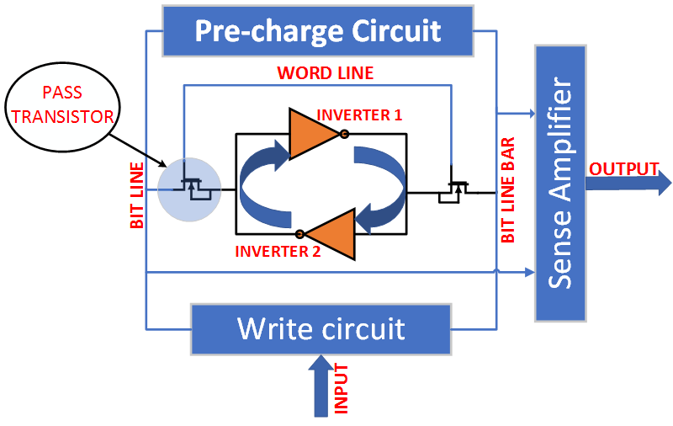
6T SRAM Cell:
The main storage element in SRAM design has been realized by CMOS technology.
CMOS circuits have inherent advantages of low power and large noise margin.
Fig: Two-inverter latch circuit with access switches
A low power SRAM cell is designed by using cross-coupled CMOS inverters.
The most important advantage of this circuit topology is that the static power dissipation is very small.
This SRAM design has high noise immunity due to larger noise margins and the ability to operate at lower power supply voltage.

Slide 4
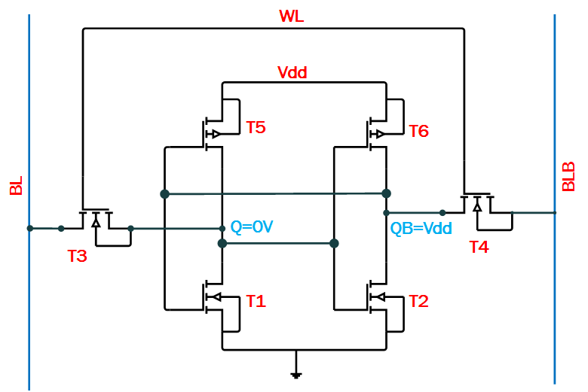
The major disadvantage of this topology is larger cell size.
The memory cell consists of simple CMOS inverters connected back to back, and two access transistors.
The access transistors are turned on whenever a word line is activated for read or write operation, connecting the cell to the BL and BLB columns.
Fig: 6T SRAM cell

Slide 5
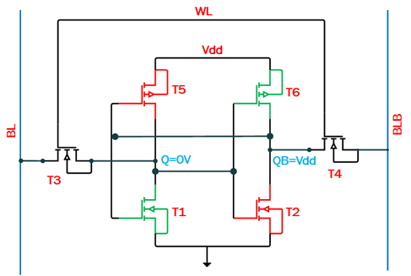
Read operation of SRAM
Fig: 6T SRAM cell during read phase
Assume memory holds value logic 0 (V1 and V2 node voltage at Q and QB.)
Initially V₁ = 0V and V₂ = V_{DD}
T2 and T5 are turned off.
T1,T3,T4 and T6 are turned on.
The voltage at column BLB do not show any significant variations since no current will flow through T4.

Slide 6
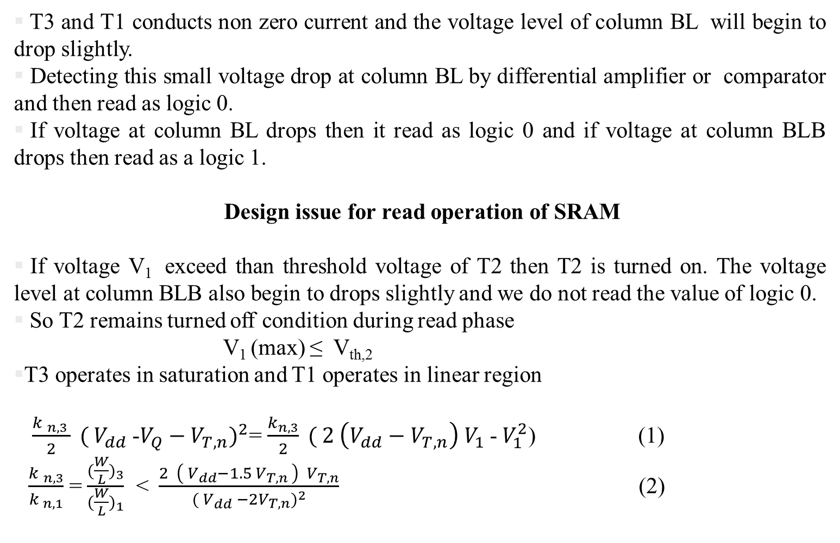
T3 and T1 conducts non zero current and the voltage level of column BL will begin to drop slightly.
Detecting this small voltage drop at column BL by differential amplifier or comparator and then read as logic 0.
If voltage at column BL drops then it read as logic 0 and if voltage at column BLB drops then read as a logic 1.
Design issue for read operation of SRAM
If voltage V₁ exceed than threshold voltage of T2 then T2 is turned on. The voltage level at column BLB also begin to drops slightly and we do not read the value of logic 0.
So T2 remains turned off condition during read phase
V₁ (max) ≤ V_{th,2}
T3 operates in saturation and T1 operates in linear region
$\frac{{k }_{n,3 }}{2} ( V_{dd}$-$V_{Q}−V_{T,n})^{2}$= $\frac{k_{n,3}}{2} ( 2 \left(V_{dd}−V_{T,n}\right){ V}_{1}$-$V_{1}^{2}$) (1)
$\frac{{k }_{n,3}}{k_{ n,1}}$=$\frac{(\frac{W}{L})_{3}}{(\frac{W}{L})_{1}}$ <$\frac{2 \left( V_{dd}−1.5 V_{T,n }\right) V_{T,n}}{( V_{dd} −2V_{T,n})^{2}}$ (2)

Slide 7
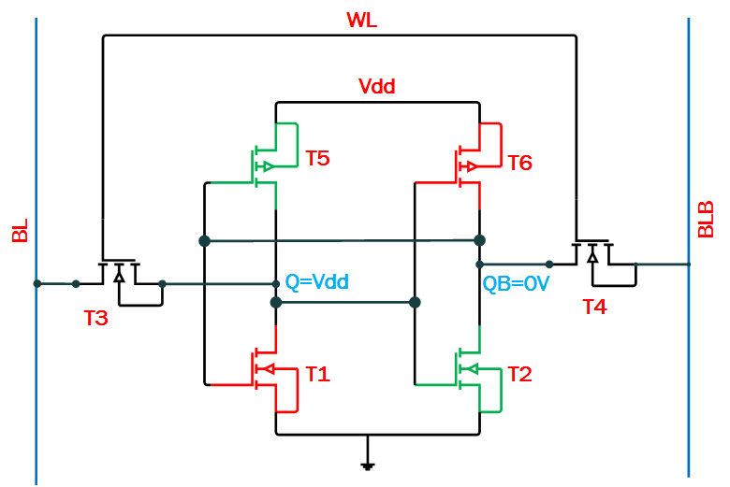
Write operation of SRAM
Fig: 6T SRAM cell through write operation
Initially assume logic 1 is stored in SRAM and we want to write logic 0.
V₁ = V_{DD} and V₂ = 0V (V₁ and V₂ is voltages of node Q and QB)
T1 and T6 are turned off.
T2, T3, T4 and T5 are turned on.
The column voltageV_{BL} is forced to logic 0 by data write circuitary.

Slide 8
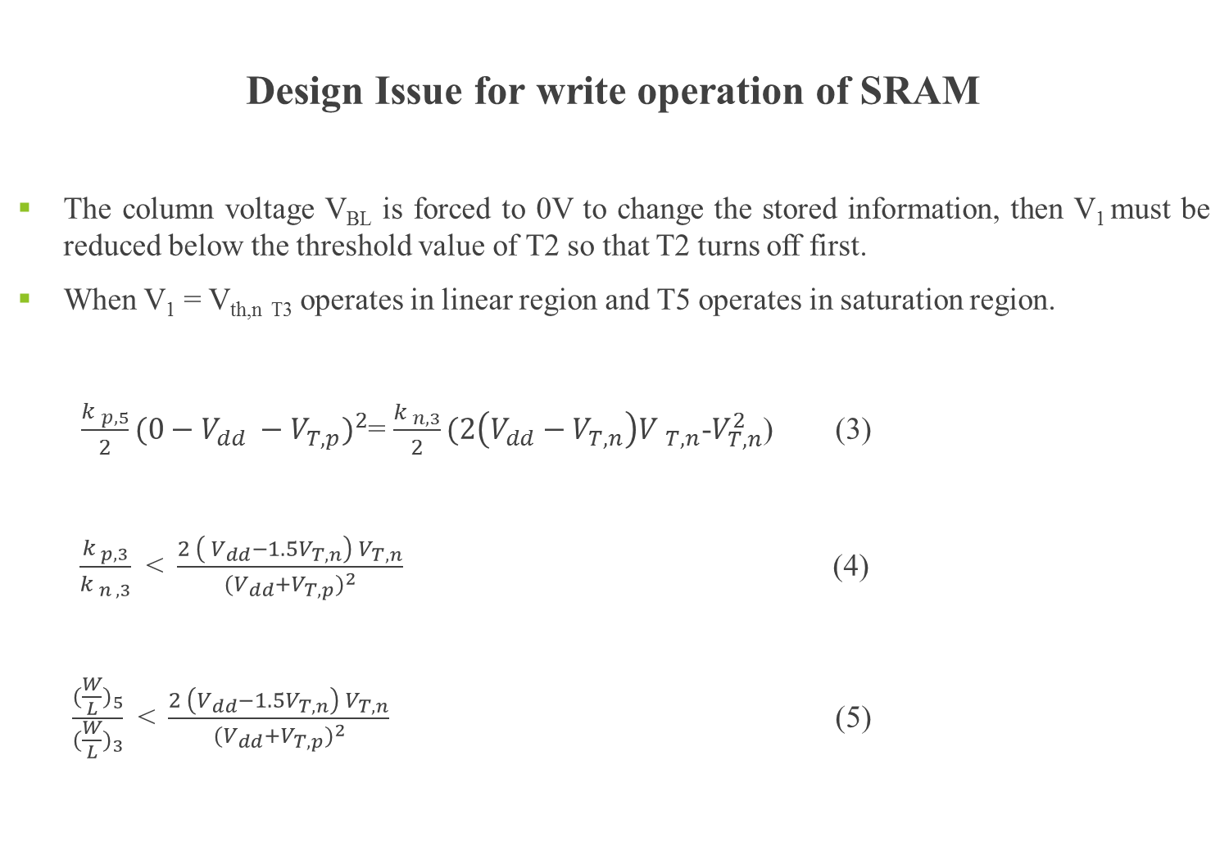
Design Issue for write operation of SRAM
The column voltage V_{BL} is forced to 0V to change the stored information, then V₁ must be reduced below the threshold value of T2 so that T2 turns off first.
When V₁ = V_{th,n T3} operates in linear region and T5 operates in saturation region.
$\frac{{k }_{p,5}}{2}(0−V_{dd} −V_{T,p})^{2}$= $\frac{{k }_{n,3}}{2}(2\left(V_{dd}−V_{T,n}\right){V }_{T,n}$-$V_{T,n}^{2}$) (3)
$\frac{k_{ p, 3}}{{k }_{n , 3}}$ <$\frac{2 \left({ V}_{dd}−1.5V_{T,n}\right) V_{T,n}}{(V_{dd}+V_{T,p})^{2}}$ (4)
$\frac{(\frac{W}{L})_{5}}{(\frac{W}{L})_{3}}$ <$\frac{2 \left(V_{dd}−1.5V_{T,n}\right) V_{T,n}}{(V_{dd}+V_{T,p})^{2}}$ (5)

Slide 9
LITERATURE SURVEY
Author | Topic | Outcome
Vijay Singh, Sanjay Kumar Singh , Raman Kapoor | Static Noise Margin Analysis of 6T SRAM Publisher: IEEE, 2020 2020 IEEE International Conference for Innovation in Technology, INOCON 2020 | In this paper 6T SRAM SNM analysed at different parameter like supply voltage , change in threshold voltage.
Rukkumani, V. Saravanakumar, M. Srinivasan, K. | Design and analysis of SRAM cells for power reduction using low power techniques. Publisher: IEEE, 2017 IEEE Region 10 Annual International Conference, Proceedings/TENCON | In this paper different SRAM cell is implemented and compare for fower
Suneja, Divya Chaturvedi, Nitin Gurunarayanan, S. | A comparative analysis of read/write assist techniques on performance & margin in 6T SRAM cell design Publisher: IEEE, 2017 2017 International Conference on Computer, Communications and Electronics, COMPTELIX 2017 | In this work, read and write assist technique is discussed
Penki.Rohit , Dr. Gera. Anjaneyulu | Analysis and Performance Comparison of Different SRAM Cells International Journal of Advanced Research in Electronics and Communication Engineering (IJARECE) Volume 6, Issue 7, July 2017 | In this paper sram cell having different no of transistor are studied
Do, Anh Tuan Kong, Zhi Hui Yeo, Kiat Seng | Hybrid-mode SRAM sense amplifiers: New approach on transistor sizing Publisher: IEEE, 2008 IEEE Transactions on Circuits and Systems II: Express Briefs | In this paper SRAM sense amplifier is discussed

Slide 10
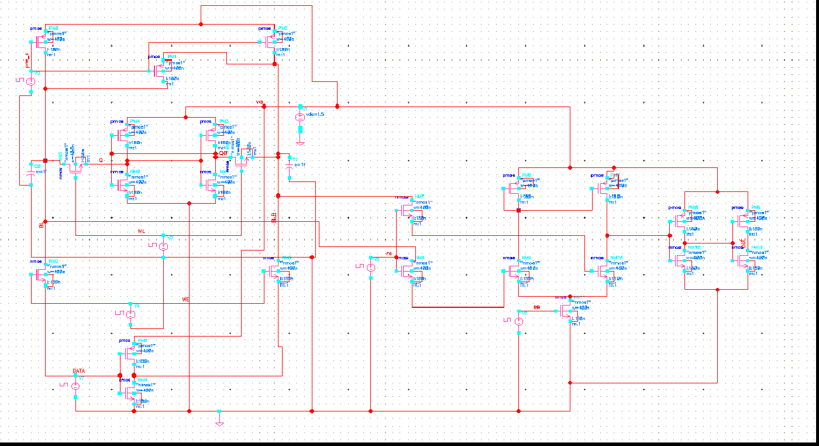
PRE_CHARGE CIRCUIT
Read Circuit
Sense Amplifier
6T SRAM_CELL
Write Circuit
Fig. Analysis of 1-bit cell schematic

Slide 11
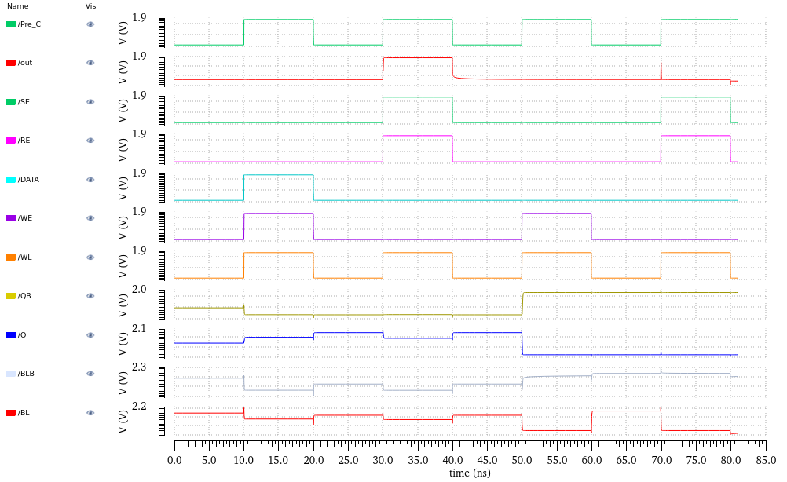
Write 1
Read 1
Write 0
Read 0
Fig. Timing Analysis of 1-Bit Cell

Slide 12
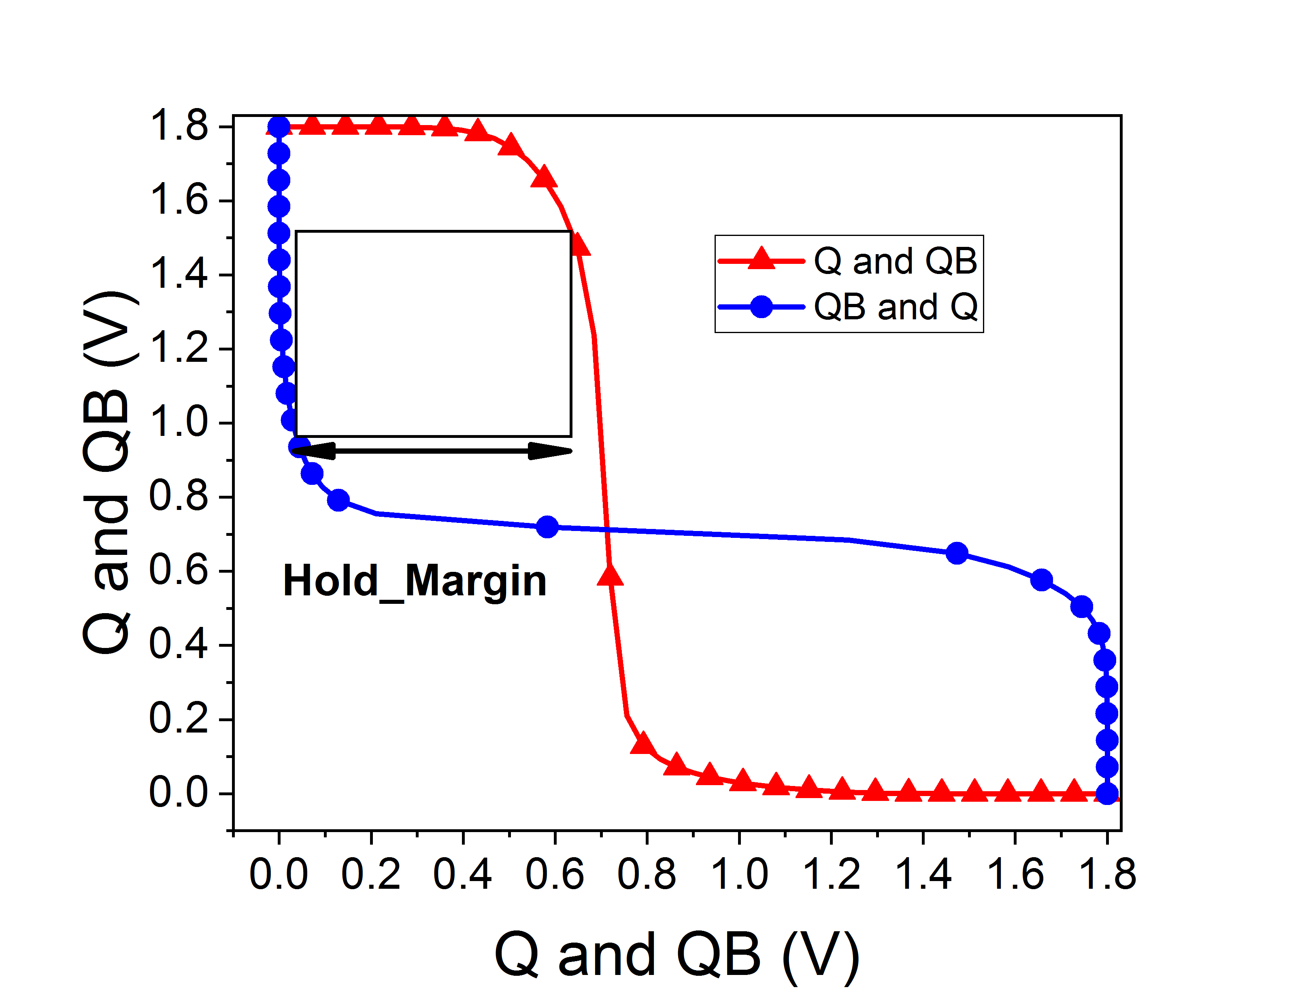
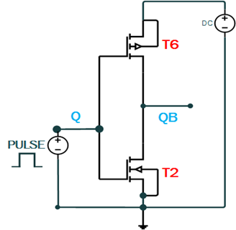
SRAM Parameter And Analysis
The SNM is used to determine the stability of the SRAM. SNM is the lowest noise voltage needed to modify the cell state. Plotting the butterfly curve is one way of measuring the SNM. The voltage_transfer_characterstics of the inverter is traced and mirrored to construct the butterfly curve. Then determining the greatest square possible between them . SNM is equal to the size of the square's side inscribed between them.
SNM_H (Static_Noise _margin_Hold)
SNM _H is amount of noise which can be added during the hold period to flip the stored data in the cell and is calculated by using the following circuit.
Fig. 5 circuit for finding SNM_H of the 6T SRAM_Cell
Fig.6 SNM_H of 6T SRAM_Cell (Q and QB is storage node of the Cell)

Slide 13
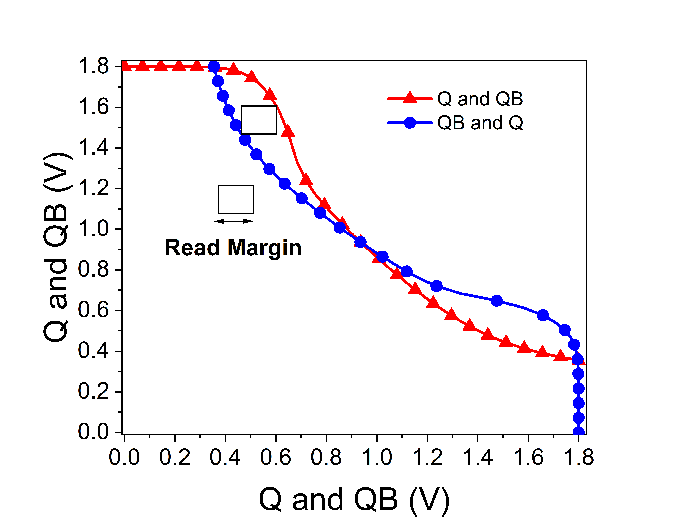
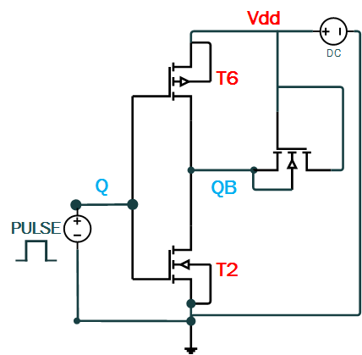
SNM_R (Static_Noise_Margin_Read)
SNM_R is read stability parameter that determine the ability to prevent the SRAM_Cell from flipping the stored value while reading data from the cell. The circuit for calculating SNM_R is given in Fig.7.
Fig. 7 circuit for finding SNM_R of 6T SRAM_Cell
Fig. 8 SNM_R of 6T SRAM Cell(Q and QB is storage node of the Cell)

Slide 14
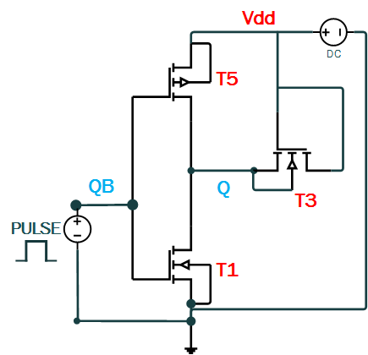
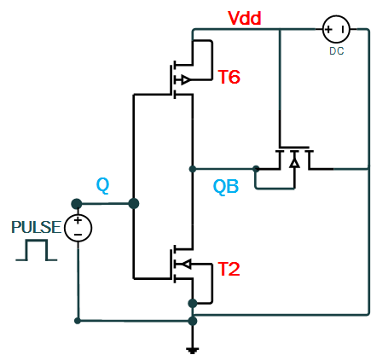
SNM_W (Static_Noise_Margin_Write)
SNM_W is criteria used to measure the write stability of the SRM Cell. During write mode since BL and BLB are complement of each other because data is given to BL and data_bar is given to the BLB hence there will be two separate circuit for calculating the write margin as depicted in the Fig.9(a) and Fig.9(b).
Fig 9(a) Circuit for finding SNM_W of 6T SRAM Cell
Fig 9(a) Circuit for finding SNM_W of 6T SRAM Cell
Fig. 10 SNM_W of 6T SRAM Cell (Q and QB is storage node of the Cell)

Slide 15
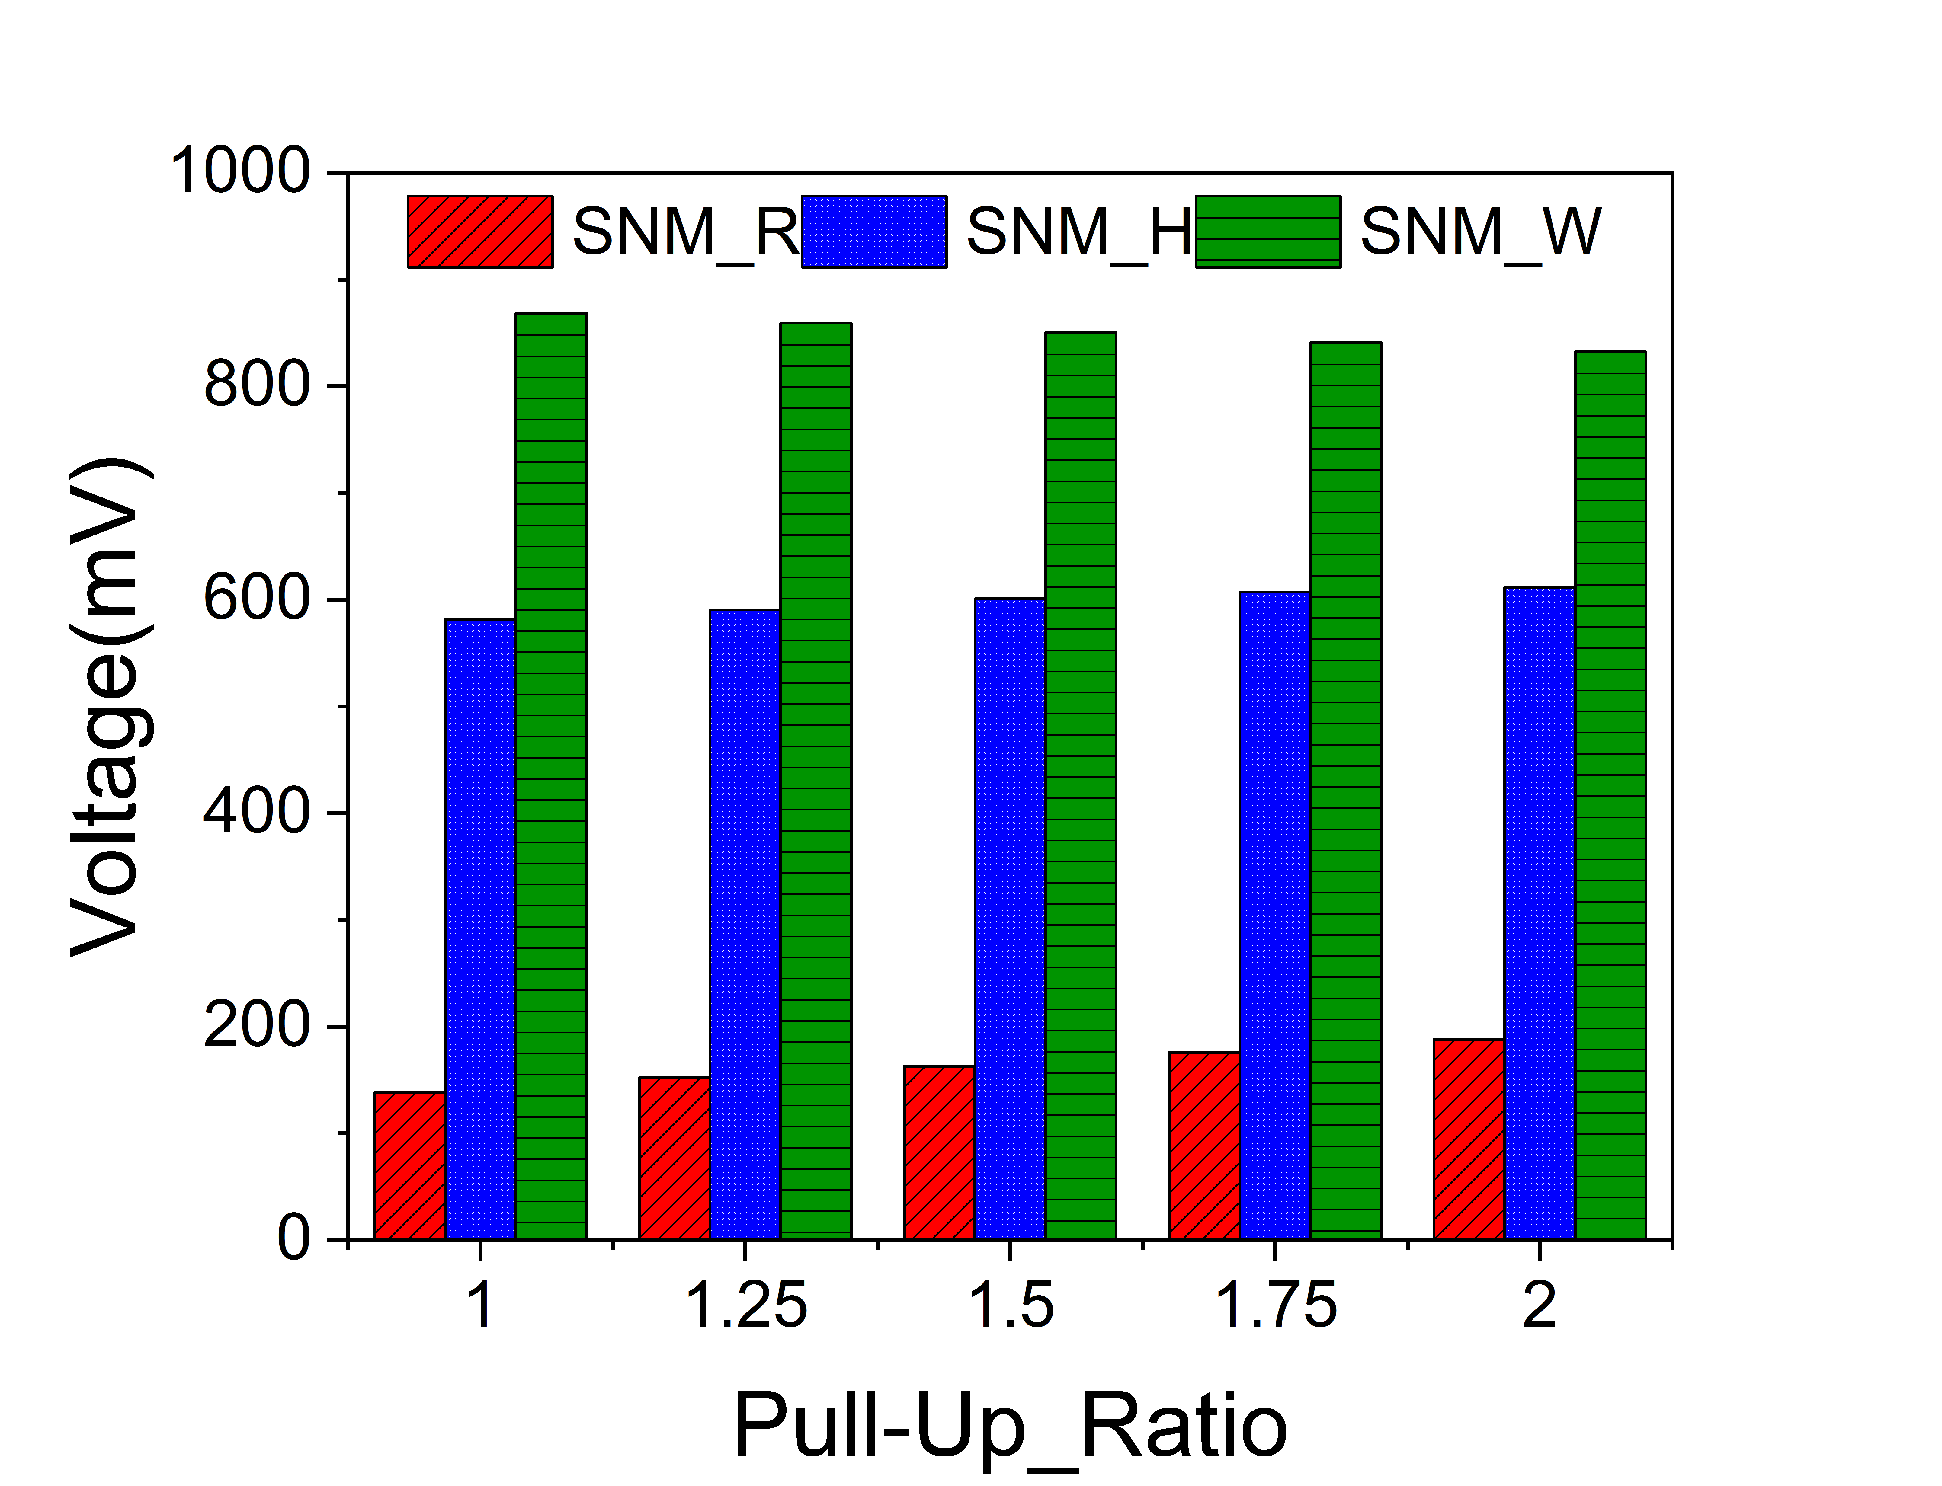
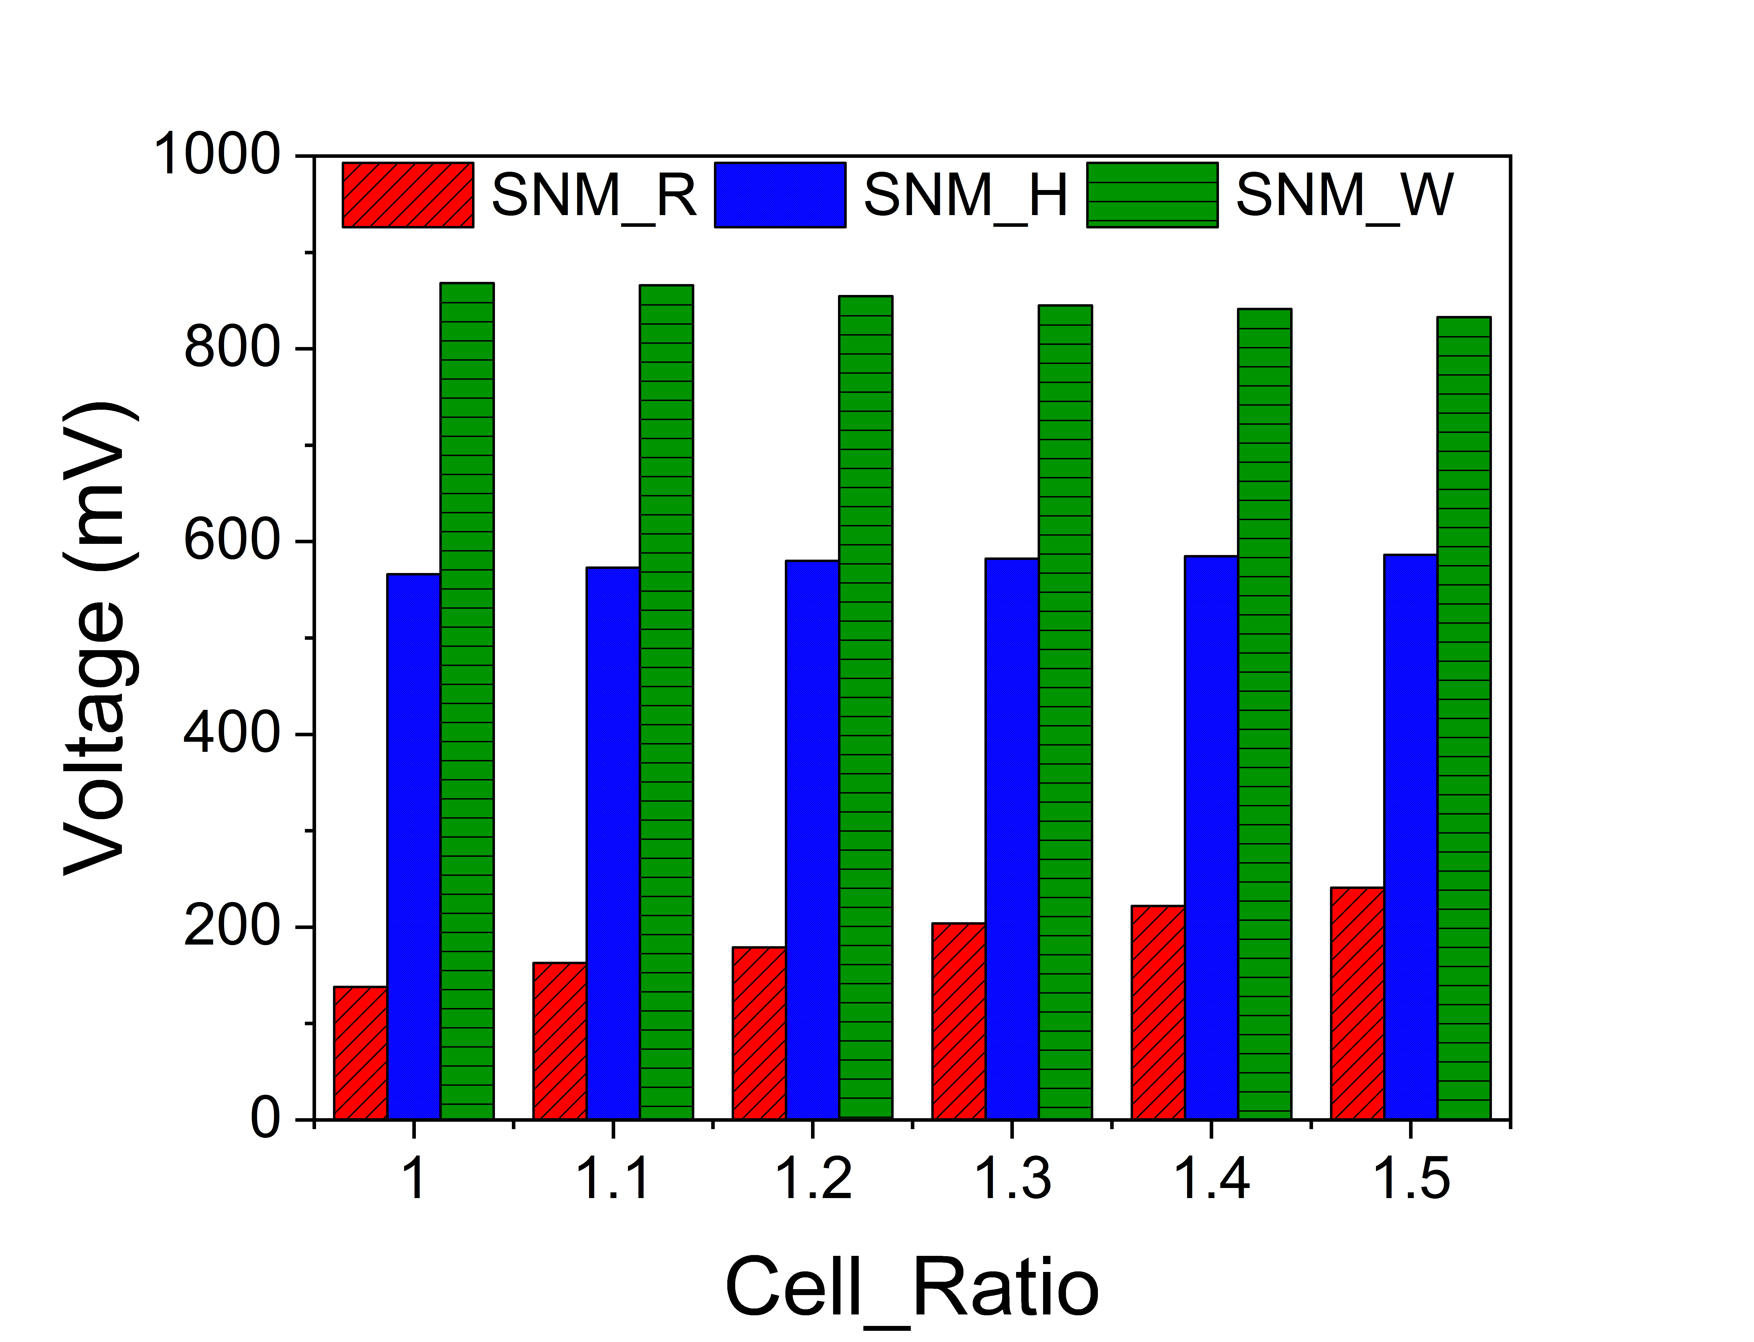
Variation of Different SRAM Parameter at Different Cell_Ratio and Pull-up_Ratio
Fig. 11 Variation of different parameter keeping CR=1
Fig. 12 Variation of different parameter keeping CR=1
Table.1 Width of different transistor during CR=1
Table.2 Value of different transistor during PR=1
Transistor | T1 (nm) | T2 (nm) | T3 (nm) | T4 (nm) | T5 (nm) | T6 (nm)
Width | 400 | 400 | 400 | 400 | variable | variable
Transistor | T1 (nm) | T2(nm) | T3 (nm) | T4 (nm) | T5 (nm) | T6 (nm)
Width | variable | variable | 400 | 400 | 400 | 400

Slide 16
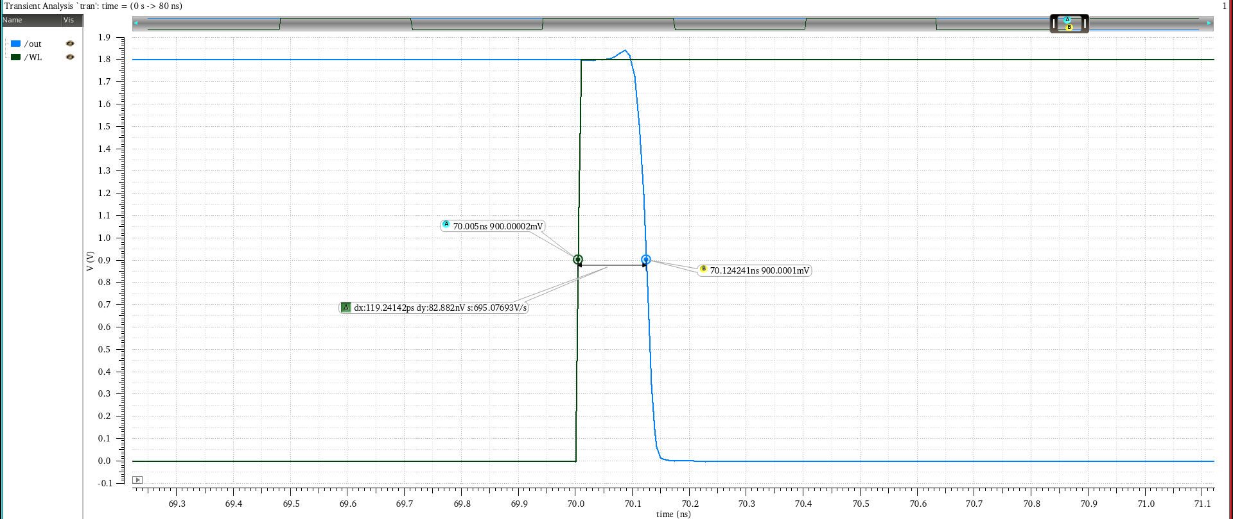
Read_Delay Analysis
Fig. Plot of WL and Out
We have calculated the Read_Delay as the difference between the time when WL reaches 50% of its value to when the output transit to 50% of its value when we are reading the data and WL and read_enable is high.

Slide 17
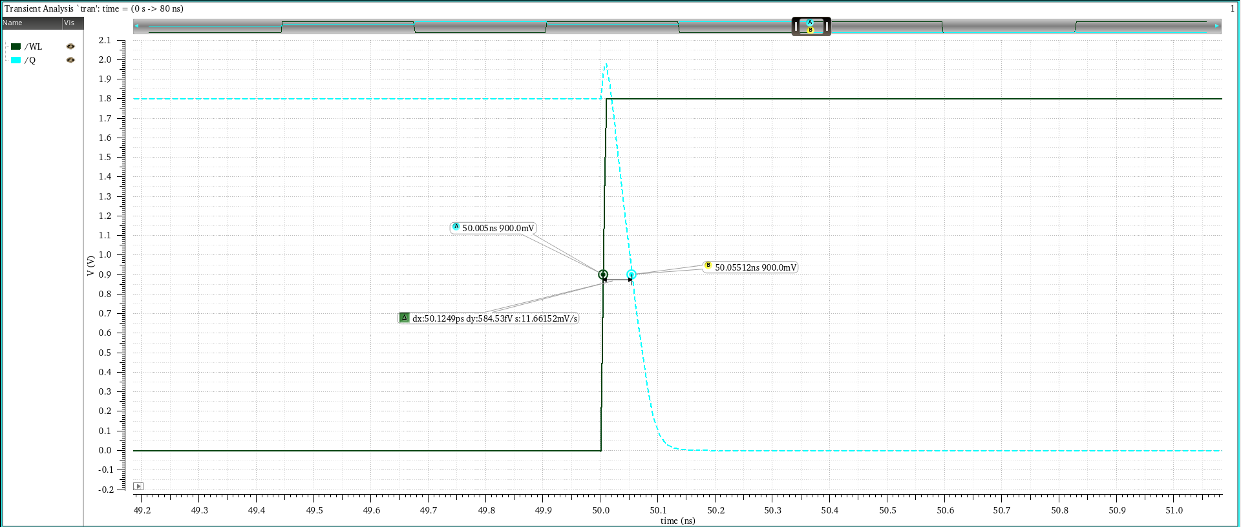
Write_Delay Analysis
Fig. Plot of WL and Node Q
We have calculated the write_Delay as the difference between the time when WL reaches 50% of its value to when the Q reaches 50% of the value when we are writing in the cell and WL is high.

Slide 18
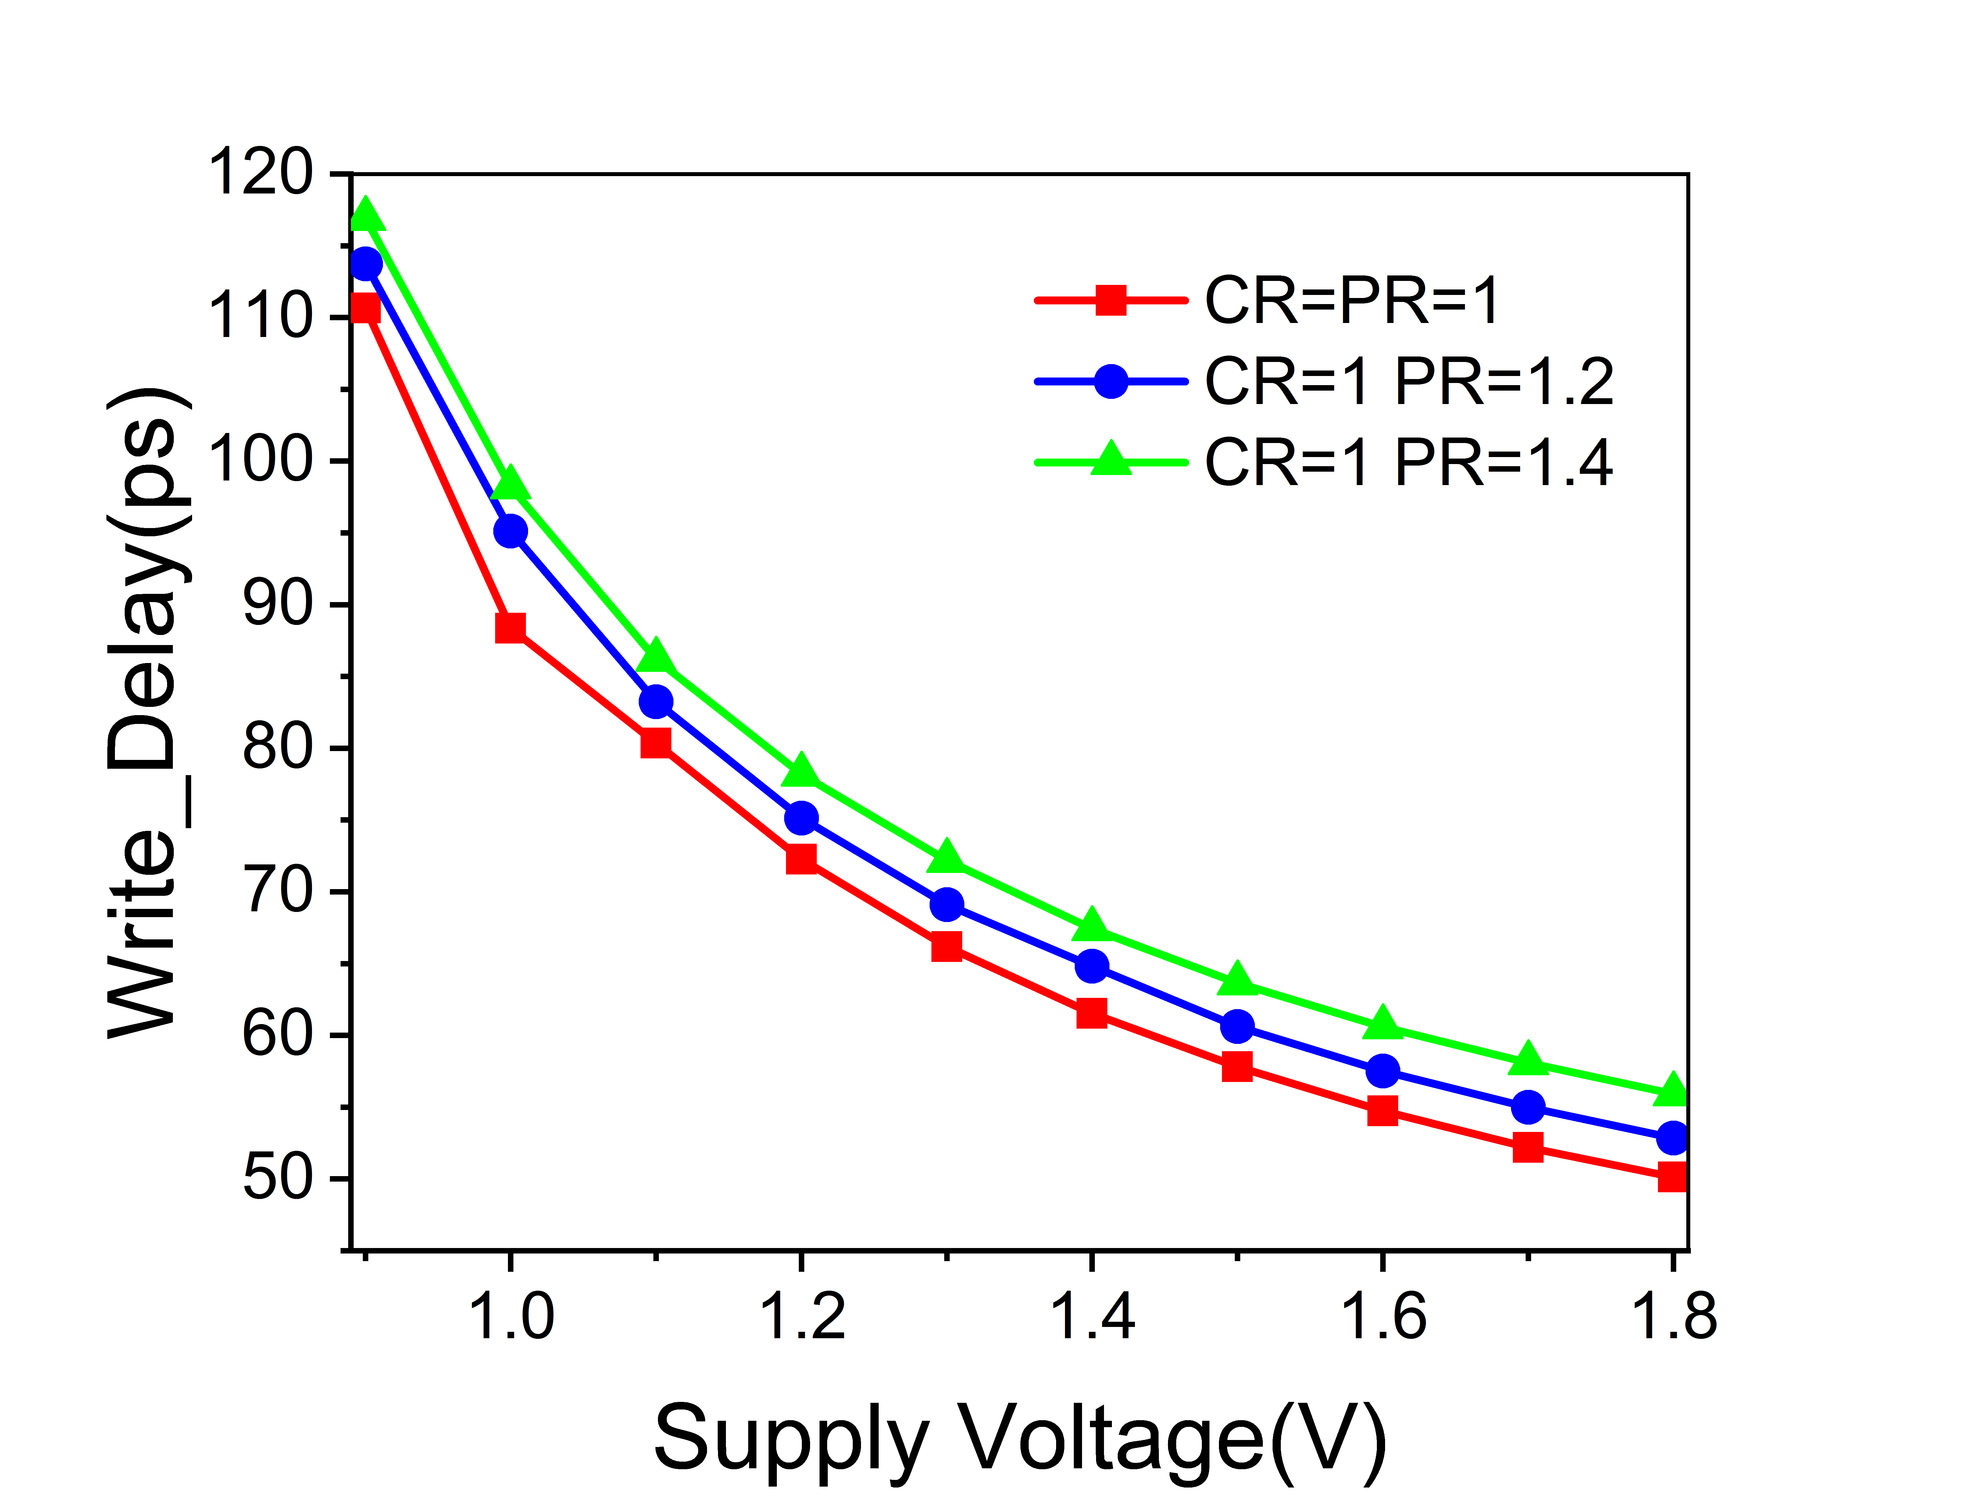
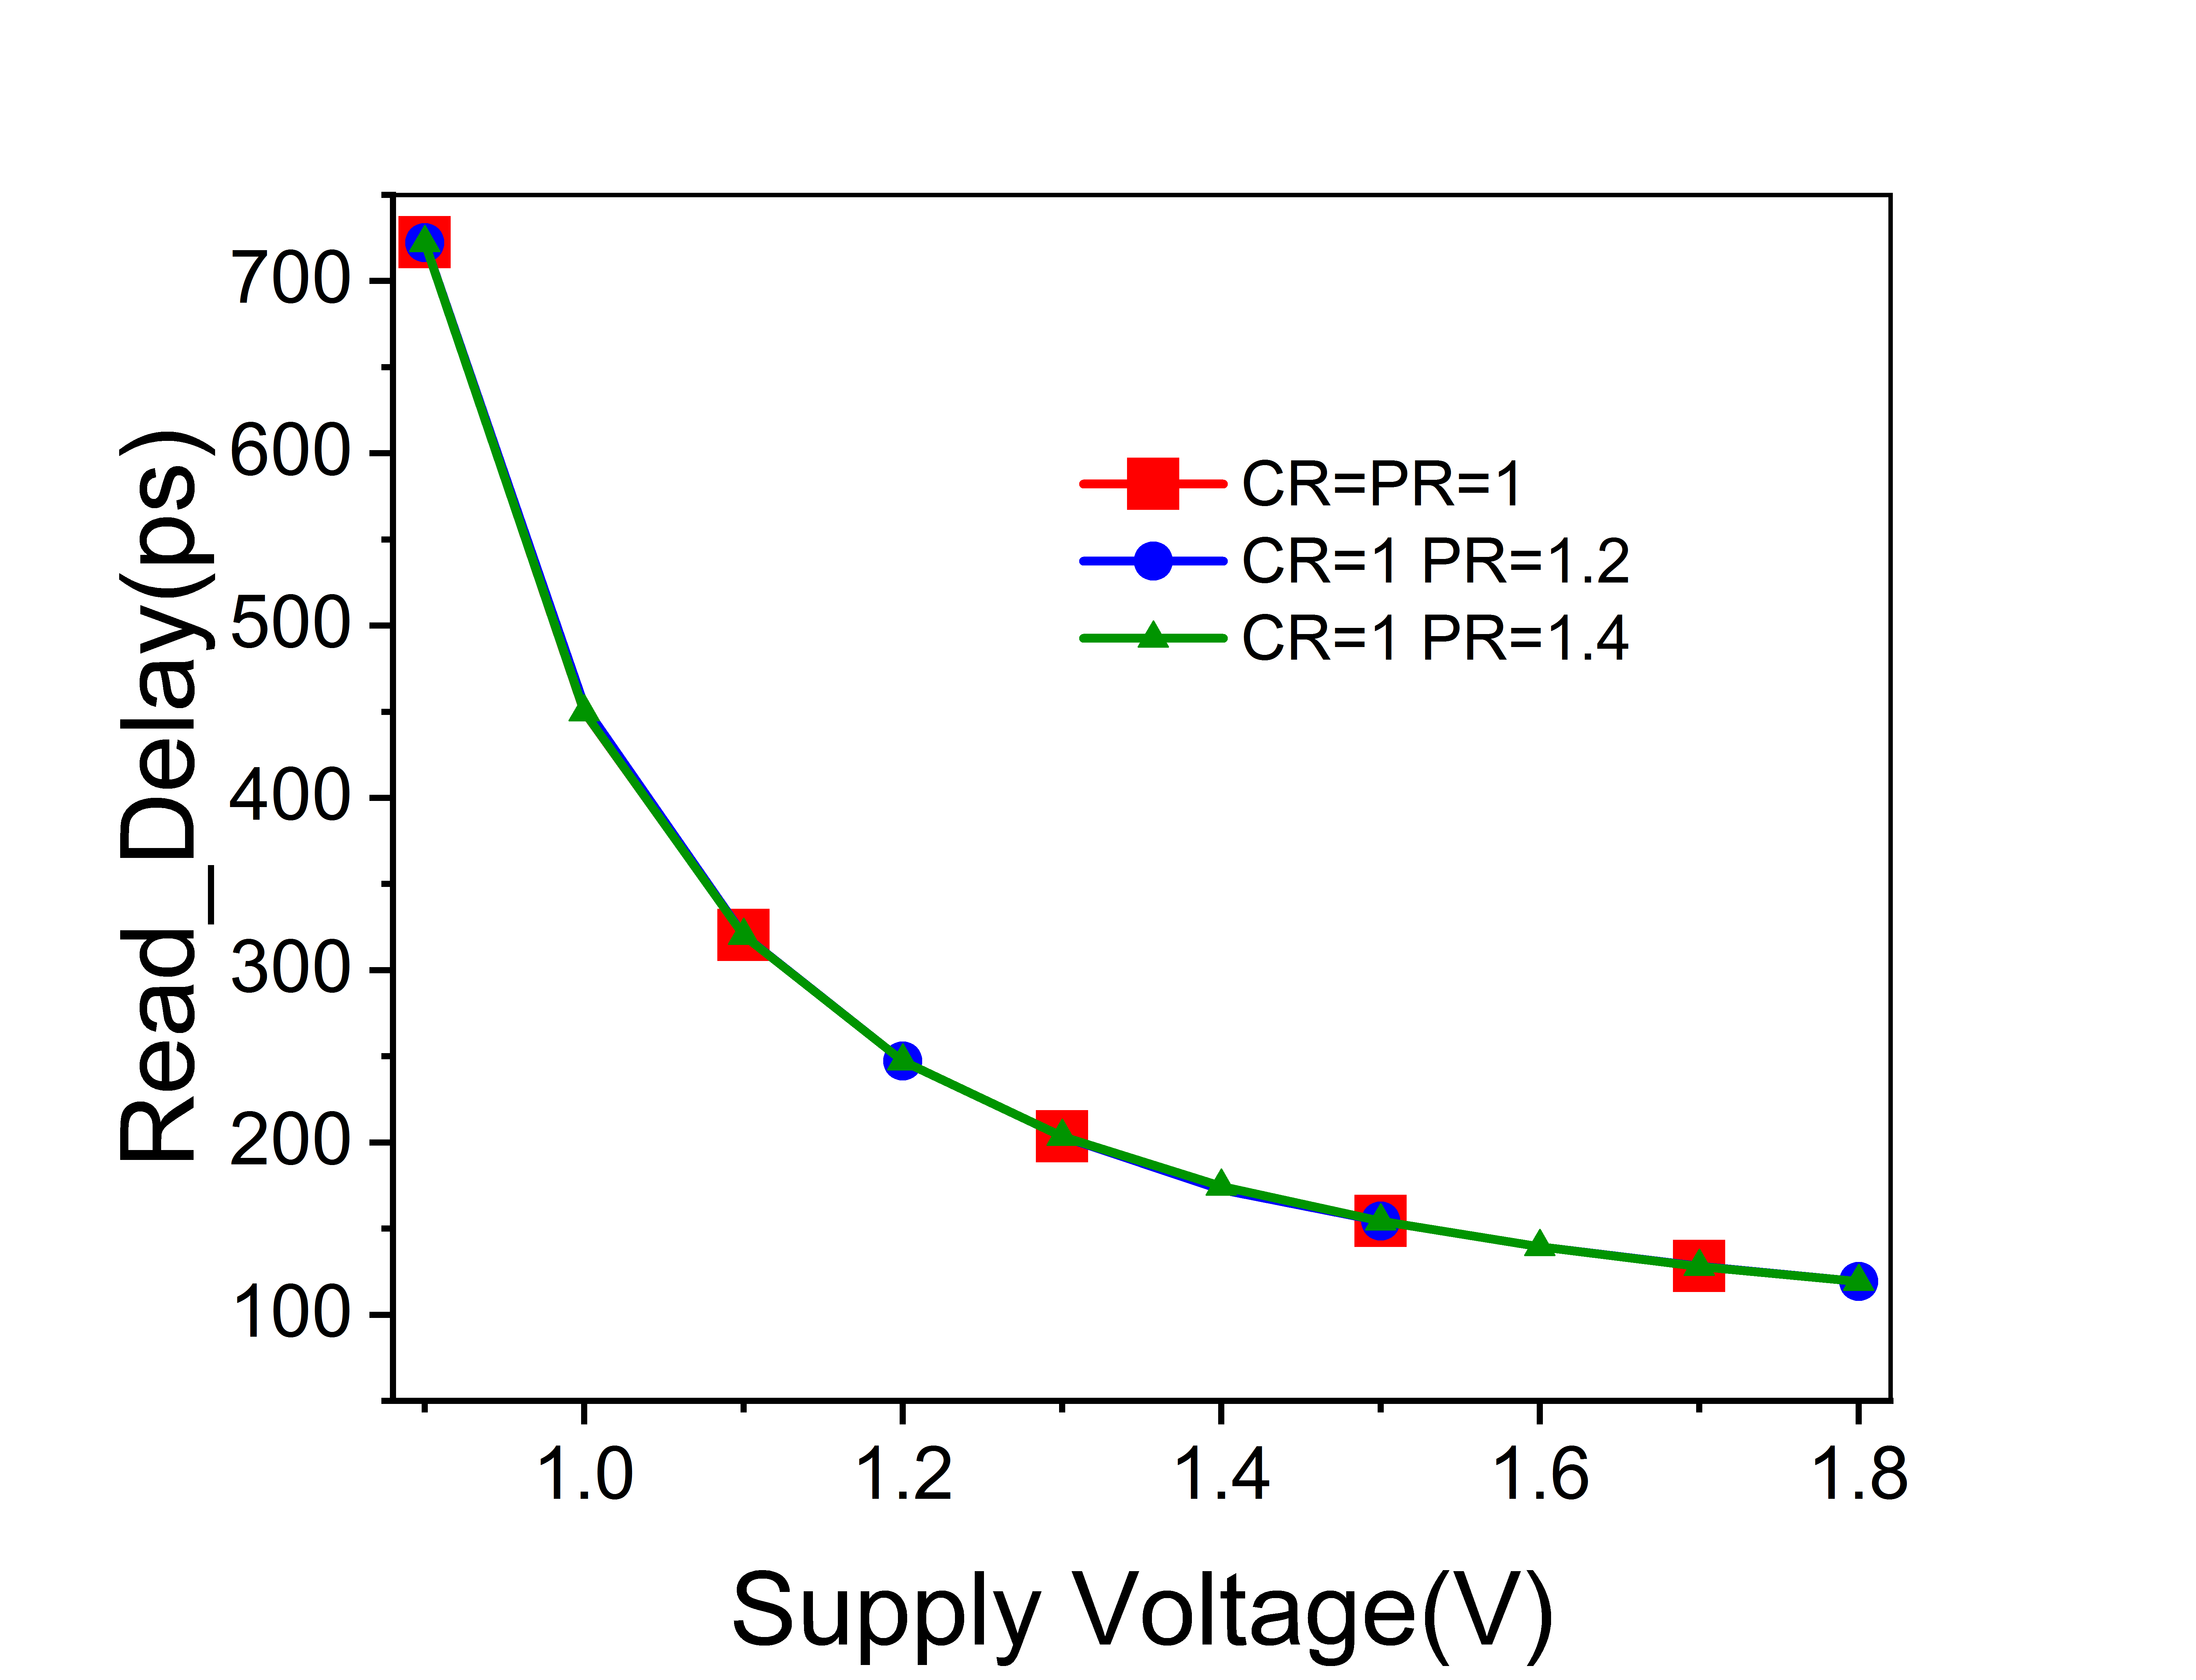

Read and Write Delay at Different Supply Voltage
Fig.13 Write_delay at at different Supply voltage and different Pull_up ratio
Fig.14 Read_delay at various PR and $V_{dd}$

Slide 19
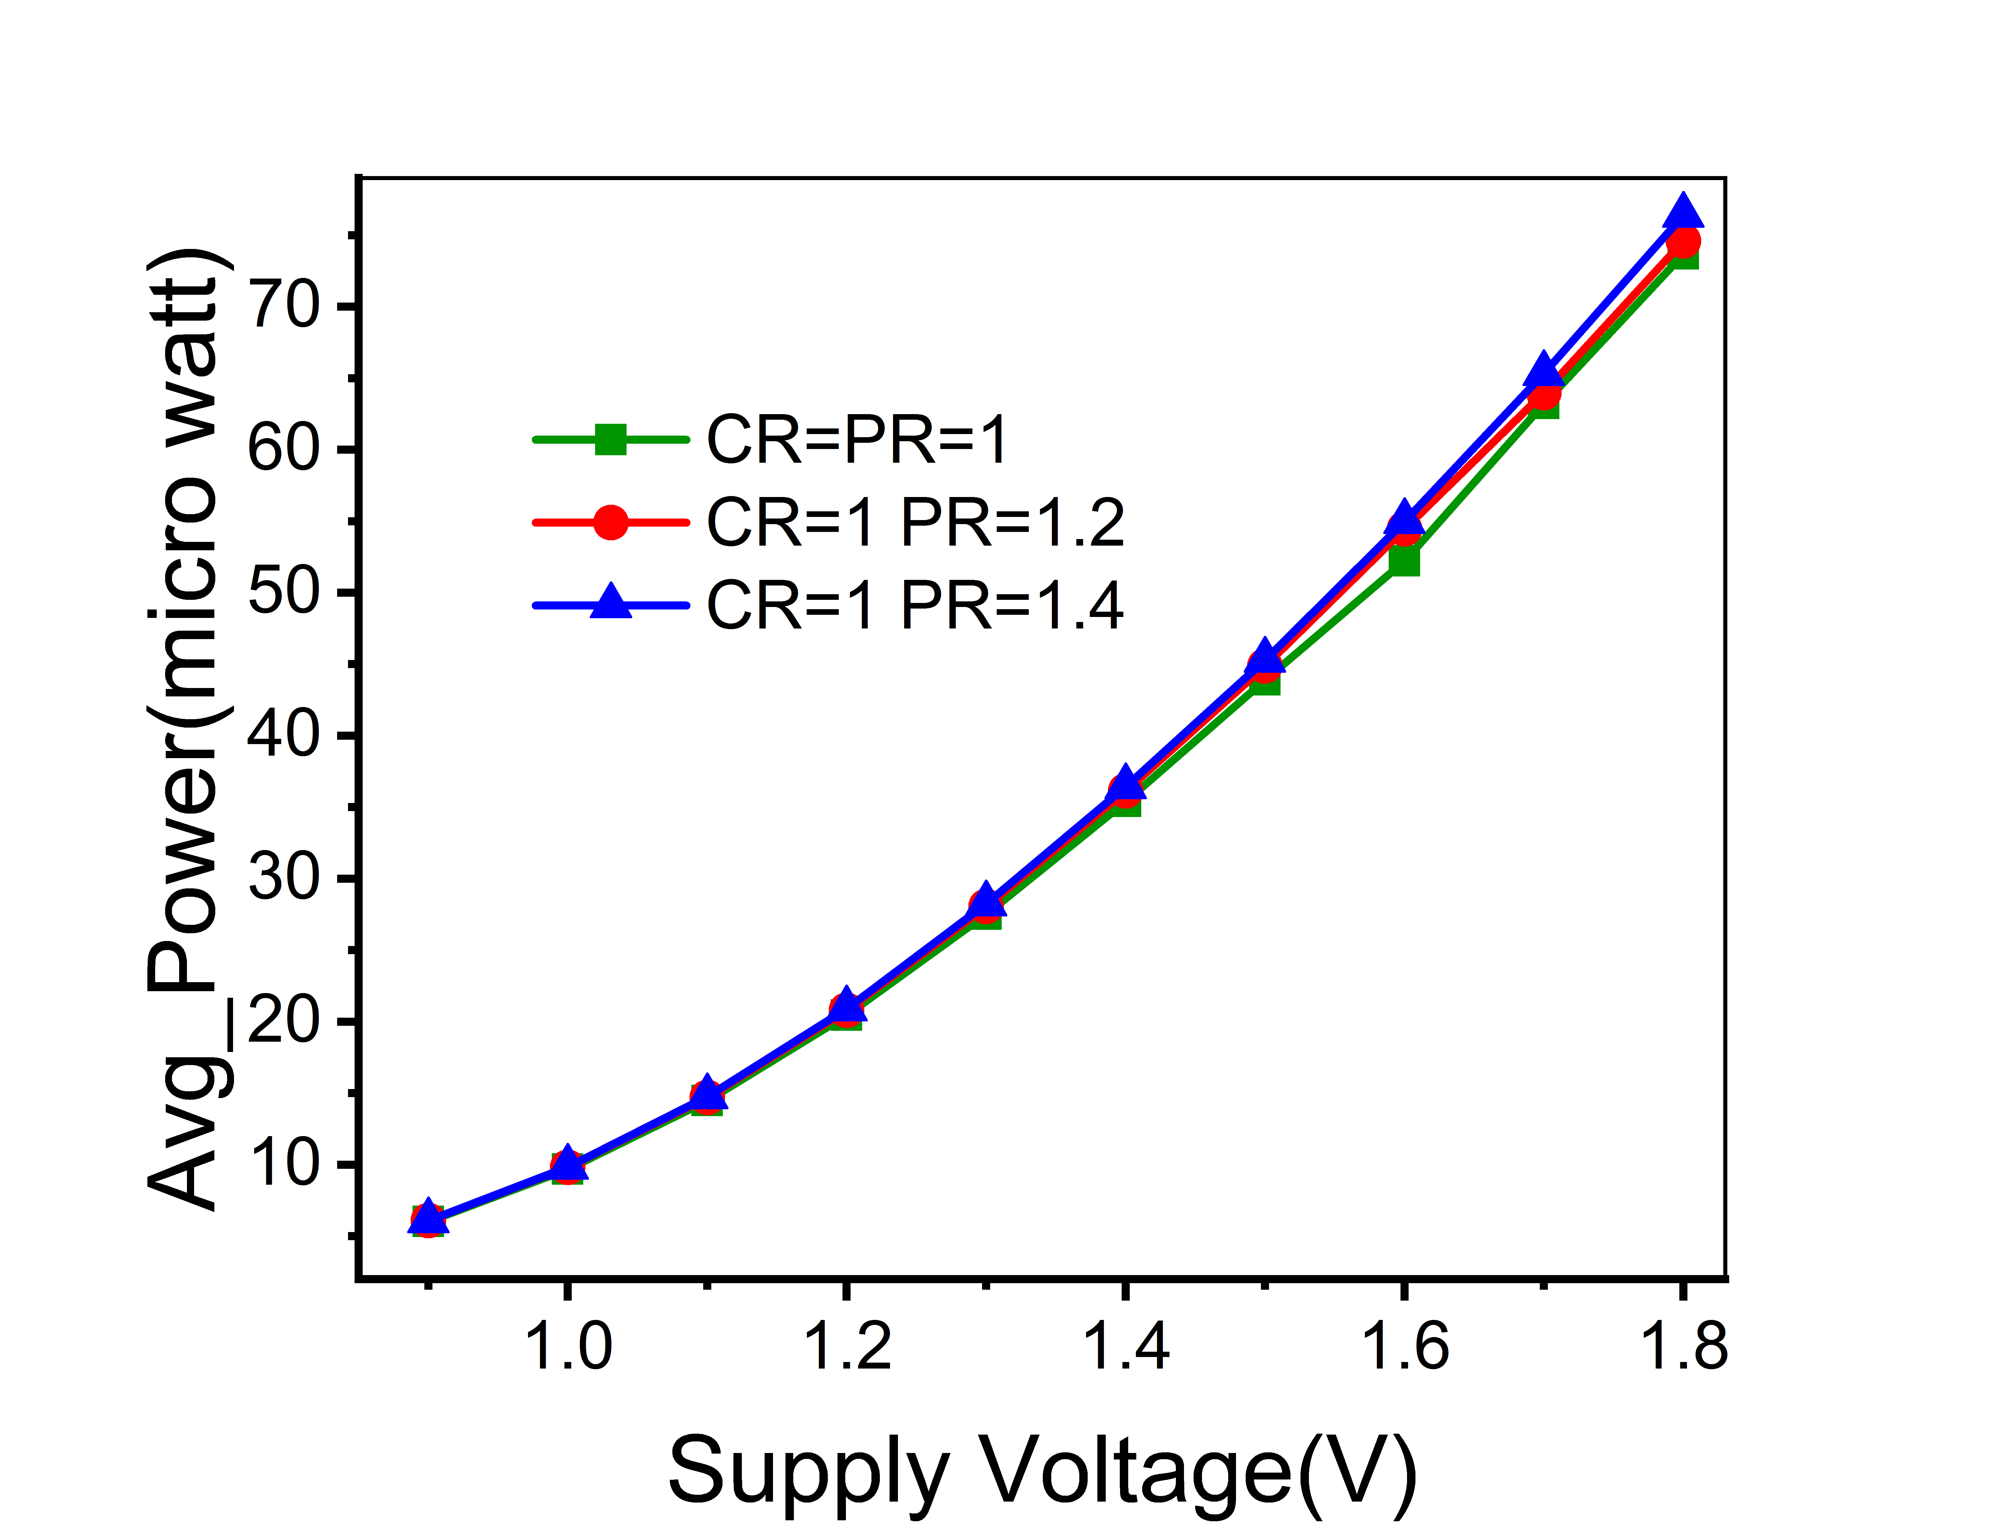
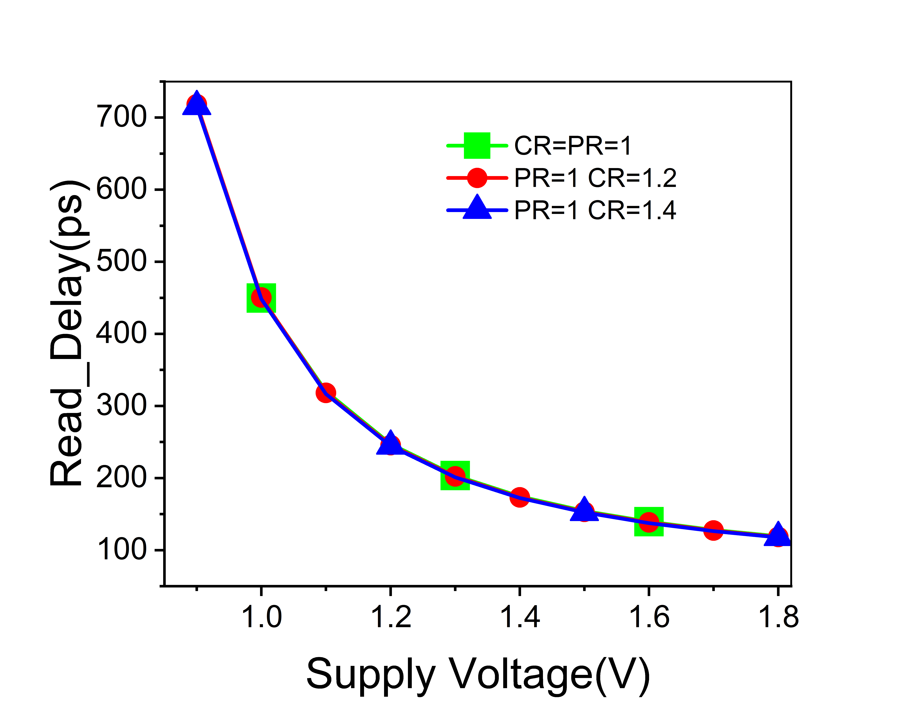
Read_Delay at and Avg_Power Dissipation at Different Supply Voltage
Fig. 15 Average PD at different PR and $V_{dd}$
Fig.16 Read_delay of 6T SRAM at various CR and $V_{dd}$

Slide 20
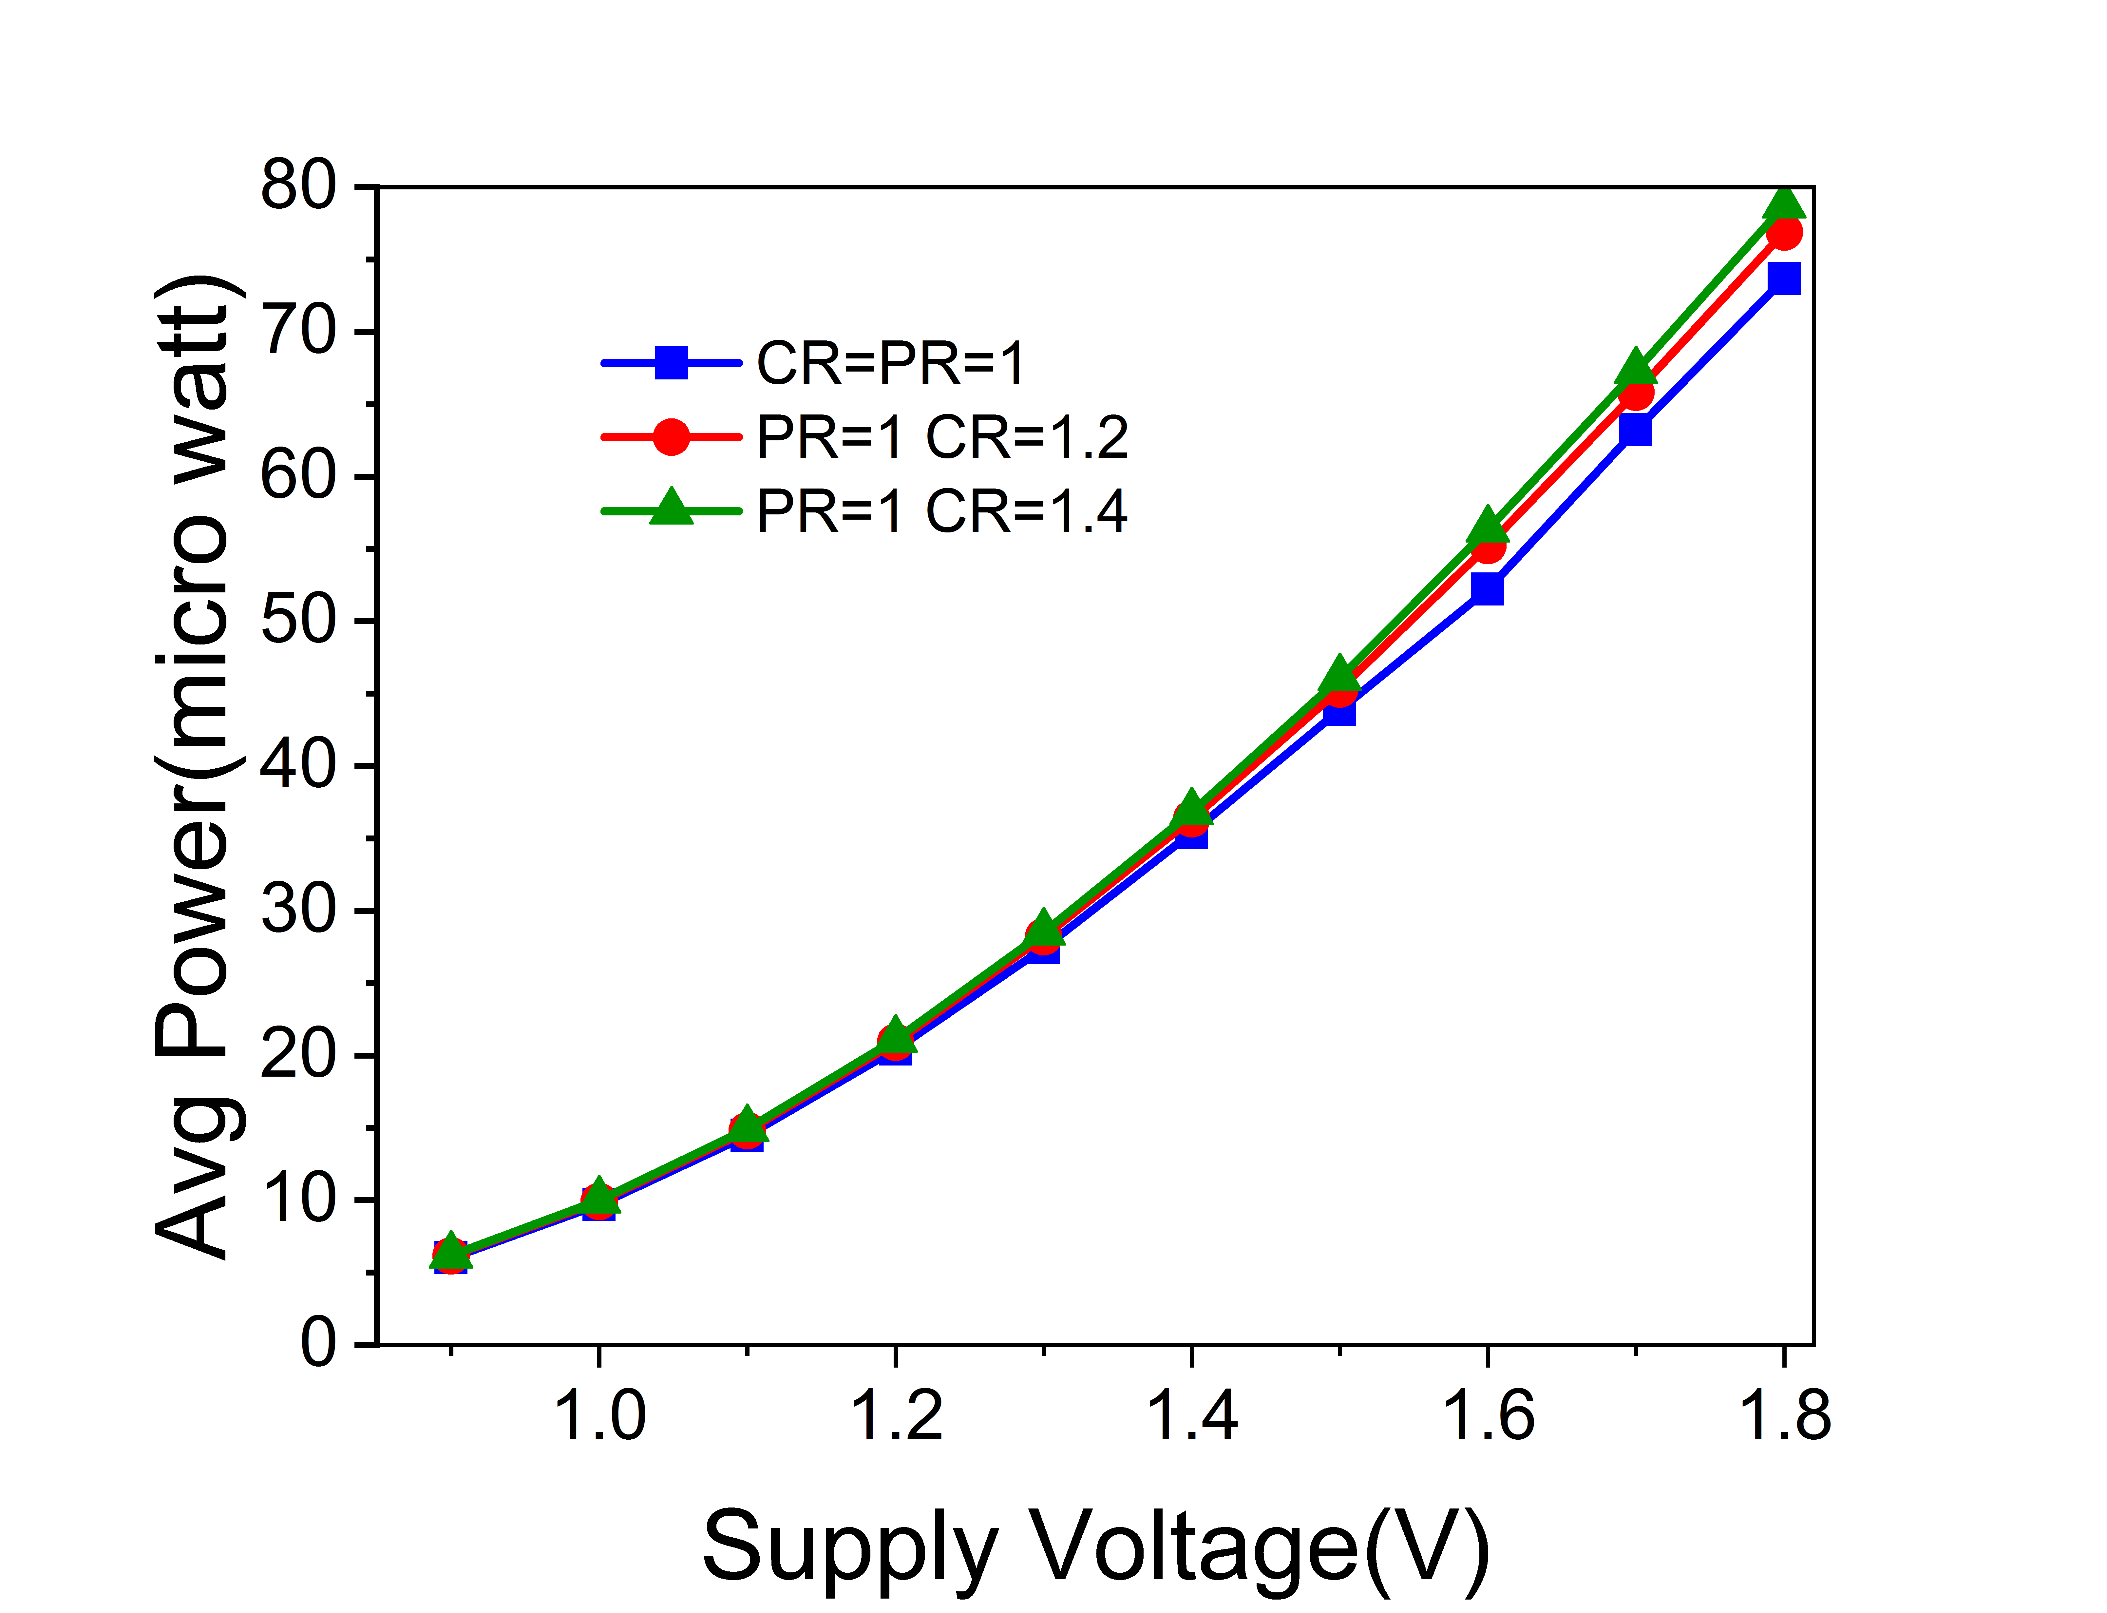
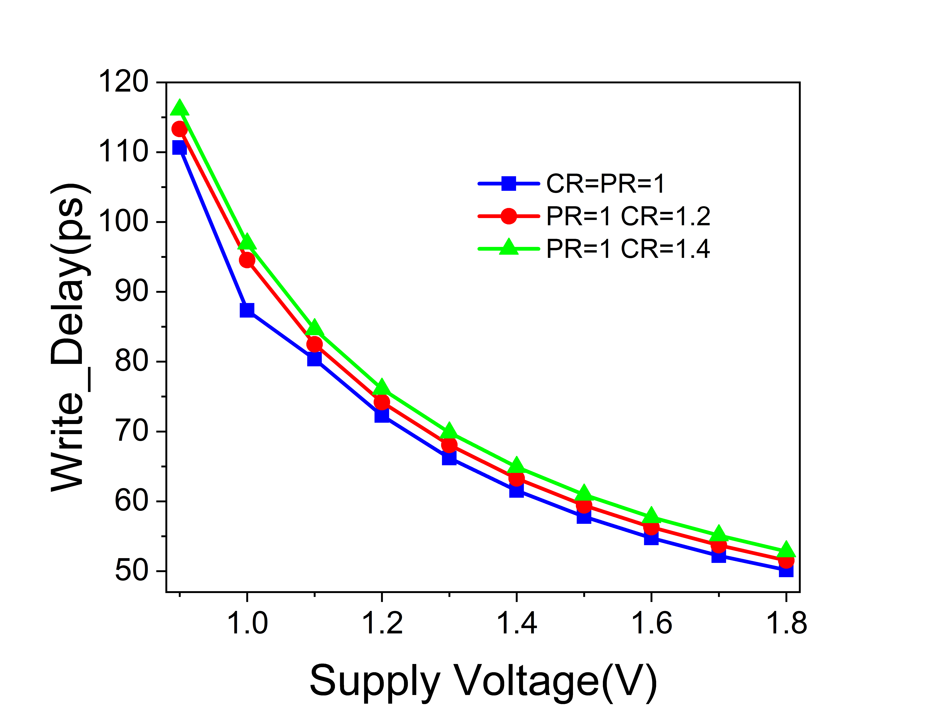

Write_Delay at and Avg_Power Dissipation at Different Supply Voltage
Fig. 15 Average PD at different CR and $V_{dd}$
Fig.16 Write_delay of 6T SRAM at various CR and $V_{dd}$

Slide 21
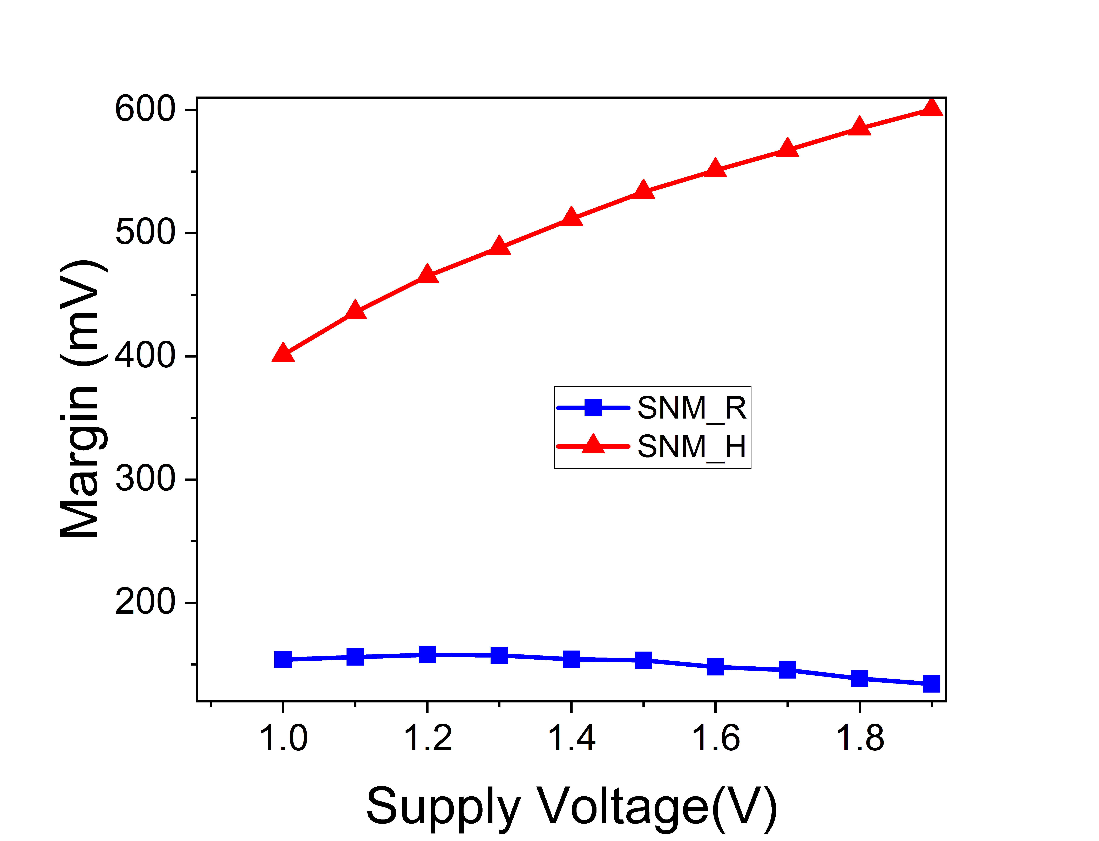
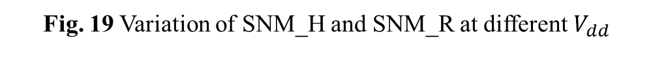
SNM_H and SNM_R Variation with Supply Voltage
Fig. 19 Variation of SNM_H and SNM_R at different $V_{dd}$

Slide 22
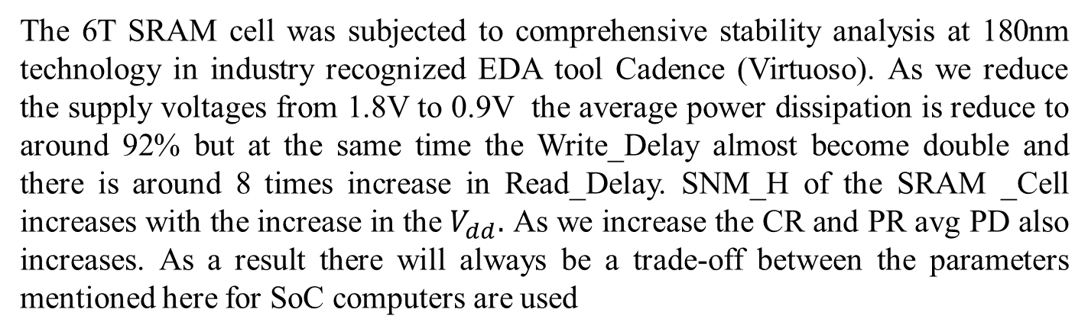
SUMMARY
The 6T SRAM cell was subjected to comprehensive stability analysis at 180nm technology in industry recognized EDA tool Cadence (Virtuoso). As we reduce the supply voltages from 1.8V to 0.9V the average power dissipation is reduce to around 92% but at the same time the Write_Delay almost become double and there is around 8 times increase in Read_Delay. SNM_H of the SRAM _Cell increases with the increase in the $V_{dd}.$ As we increase the CR and PR avg PD also increases. As a result there will always be a trade-off between the parameters mentioned here for SoC computers are used

Slide 23
Reference
[1] O. Mutlu, “Rethinking Memory System Design,” pp. 1–3, 2017, doi: 10.1109/mst.2016.12.
[2] V. Singh, S. K. Singh, and R. Kapoor, “Static Noise Margin Analysis of 6T SRAM,” 2020 IEEE Int. Conf. Innov. Technol. INOCON 2020, pp. 6–9, 2020, doi: 10.1109/INOCON50539.2020.9298431.
[3] R. Barth, “ITRS Commodity Memory Roadmap,” pp. 3–5, 2009.
[4] Y. Berg, O. Mirmotahari, J. G. Lomsdalen, and S. Aunet, “High speed ultra low voltage CMOS inverter,” Proc. - IEEE Comput. Soc. Annu. Symp. VLSI Trends VLSI Technol. Des. ISVLSI 2008, pp. 122–127, 2008, doi: 10.1109/ISVLSI.2008.23.
[5] B. Dennington, “Low power design from technology challenge to great products,” Proc. Int. Symp. Low Power Electron. Des., vol. 2006, p. 213, 2006, doi: 10.1145/1165573.1165625.
[6] A. Kumar, “SRAM cell design with minimum number of transistor,” 2014 Recent Adv. Eng. Comput. Sci. RAECS 2014, pp. 6–8, 2014, doi: 10.1109/RAECS.2014.6799510.

Slide 24
[7] V. Rukkumani, M. Saravanakumar, and K. Srinivasan, “Design and analysis of SRAM cells for power reduction using low power techniques,” IEEE Reg. 10 Annu. Int. Conf. Proceedings/TENCON, pp. 30583062,2017,doi:10.1109/TENCON.2016.78409.
[8] K. Sharma and M. Mehta, “Design and Performance Analysis of 6T SRAM on 130 nm Technology,” pp. 363–368, 2019.
[9] A. Chandras and V. S. Kanchana Bhaaskaran, “Sensing schemes of sense amplifier for single-ended SRAM,” 2017 Int. Conf. Nextgen Electron. Technol. Silicon to Software, ICNETS2 2017, pp. 379–384, 2017, doi: 10.1109/ICNETS2.2017.8067964.
[10] A. T. Do, Z. H. Kong, and K. S. Yeo, “Hybrid-mode SRAM sense amplifiers: New approach on transistor sizing,” IEEE Trans. Circuits Syst. II Express Briefs, vol. 55, no. 10, pp. 986–990, 2008, doi: 10.1109/TCSII.2008.2001965.
[11] A. S. Rajput, M. Pattanaik, and R. Tiwari, “Estimation of Static Noise Margin by Butterfly Method using Curve-Fitting Technique,” J. Act. Passiv. Electron. Devices, vol. 13, no. 1, pp. 1–9, 2018.
[12] M. Yao, M. F. Cabanas-Holmen, and E. H. Cannon, “Direct Measurement Structure of SRAM SNM,” pp. 273–276.
[13] G. Torrens, B. Alorda, C. Carmona, D. Malagon-Perianez, J. Segura, and S. Bota, “A 65-nm reliable 6T CMOS SRAM cell with minimum size transistors,” IEEE Trans. Emerg. Top. Comput., vol. 7, no. 3, pp. 447–455, 2019, doi: 10.1109/TETC.2017.2721932.

Slide 25
THANK YOU!

